Slide 1



Future of Technology in Operations
Presenters:
Rishi Sareen (CTO)
Saamira Yasmin (Management Trainee)

Slide 2


DIVA – Generative AI based Chat Assistant
Customer support service
24x7 queries handling
CP, DP queries handling
Route optimization

Slide 3
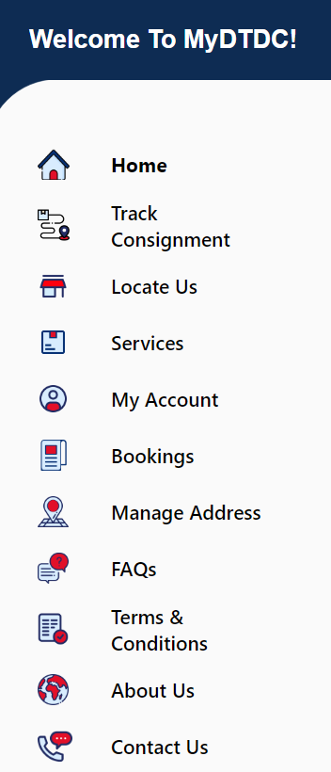


CP logged in
Hi! How can I help you?
Can you tell me how many booking shipments our arriving tomorrow?
Can you tell me how many booking shipments are arriving tomorrow?
Sure! Let me know your branch name.
Goregaon Branch
3998 Consignments have been booked as of now for
Goregaon branch.

Slide 4
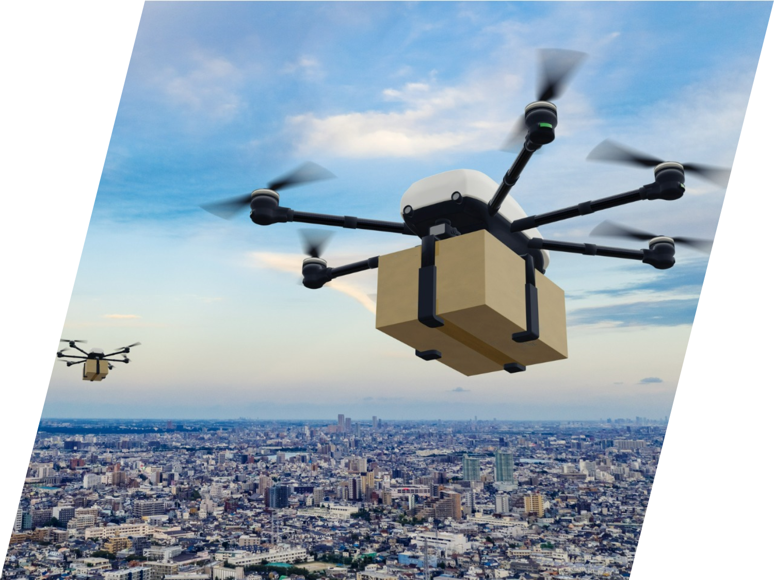
Drone Delivery

Slide 5

Artificial Intelligence and Machine learning
Prediction models for demand forecasting, identifying fraudulent customers
Application of Natural Language Processing in sentiment analysis of customer reviews
Computer Vision applications in denoising customer address images
ML in network planning and route optimisation

Slide 6

Blockchain Technology
Secured payments
Supply chain transparency
Provenance verification
Asset and inventory tracking
Cold chain monitoring

Slide 7
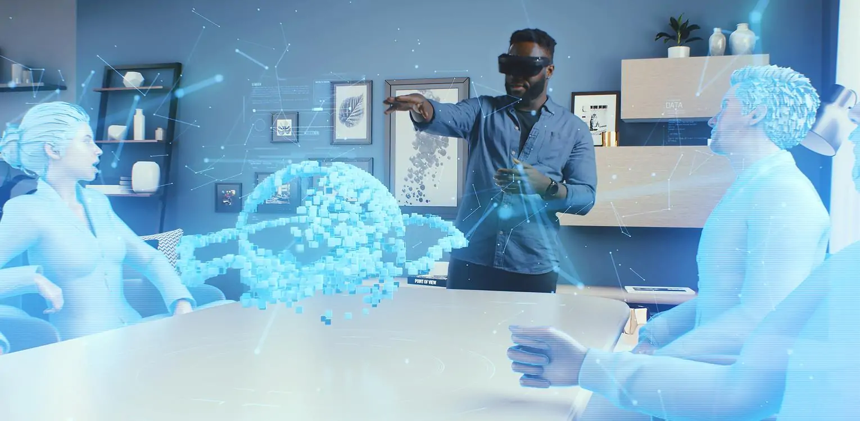
AR, VR – Sorting Shipments Made Easy

Slide 8



Can we achieve zero Carbon Footprint?
Electric Vehicles
Paperless Operations
Carbon neutral packaging

Slide 9

Let’s Grow Together

